Slide 1
Agenda
Analogy of Writing Book vs Building LLM Application
LangChain Introduction
Demo

Slide 2
Challenges in Building LLM Applications Without Frameworks
Workflow Complexity: Orchestrating components manually is error-prone.
Scalability Issues: Difficult to optimize for large-scale use.
Context Handling: Managing user data and history is challenging.
Integration Effort: Custom coding needed for external systems.
Debugging: Lacks built-in tools for tracing and error handling.

Slide 3
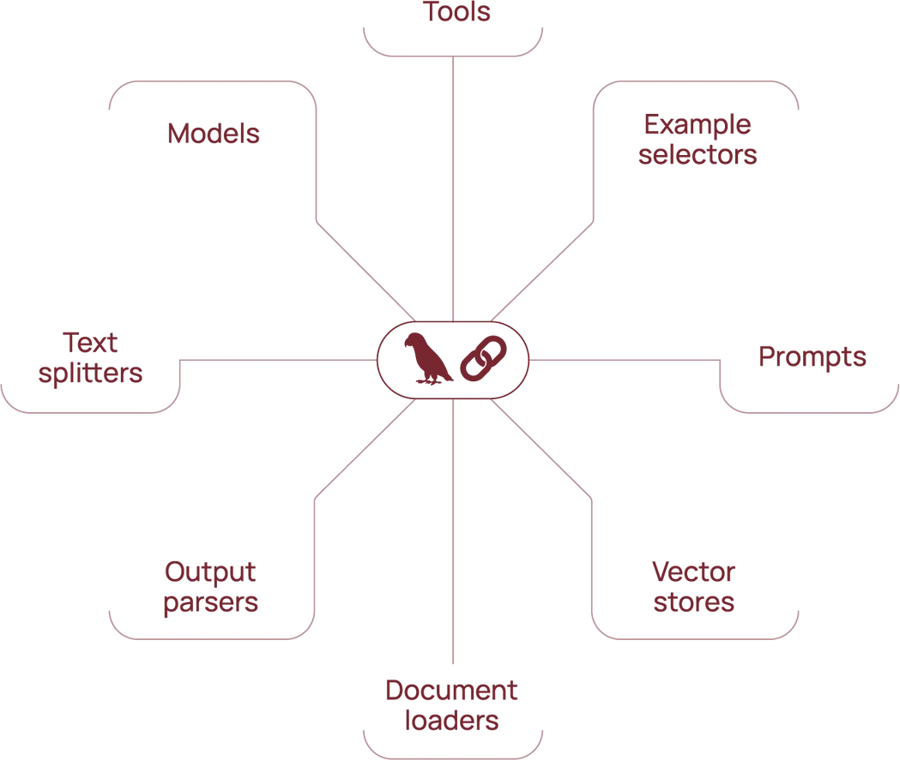
LangChain - 101
Why LangChain?
Simplifies building AI applications by offering modular components and integrations.
Core Concepts
Chat Models: Process sequences of messages. (Workflow)
Messages & Chat History: Enable contextual conversations. (Chatbot)
Tools & Tool Calling: Integrate and invoke external functionalities. (Calling third party API)
Structured Output & Memory: Ensure format consistency and retain conversational context. (Chat and Downstream)
Multimodality: Support for text, images, audio, and video.

Slide 4
LangChain - 101 - Features
Key Functionalities
Document Loaders & Retrievers: Fetch and manage knowledge.
Text Splitters & Vector Stores: Optimize data storage and search.
RAG (Retrieval-Augmented Generation): Combine LLMs with external data.
Advanced Features
Agents: Automate sequences of actions using LLMs.
Prompt Templates & Few-Shot Prompting: Standardize prompts and enhance model performance.
Async Programming & Callbacks: Enable efficient, interactive workflows.
Tracing & Output Parsers: Debug and refine results.

Slide 5
Demo
Prerequisites
Gemini Access:
Google account with Gemini API, Cloud SDK enabled for Project.
Elasticsearch Setup:
Elastic Cloud or self-hosted Elasticsearch instance with Cloud ID and API Key.
Overview
Parsing and Handling Prompts with LangChain: Crafting and sending AI queries.
Validating AI Responses with Pydantic: Ensuring data structure and correctness
Using Google Gemini for AI Model Generation: Leveraging robust capabilities to generate AI responses.
Indexing AI Responses in Elasticsearch: Storing and managing AI-generated data.

Slide 6
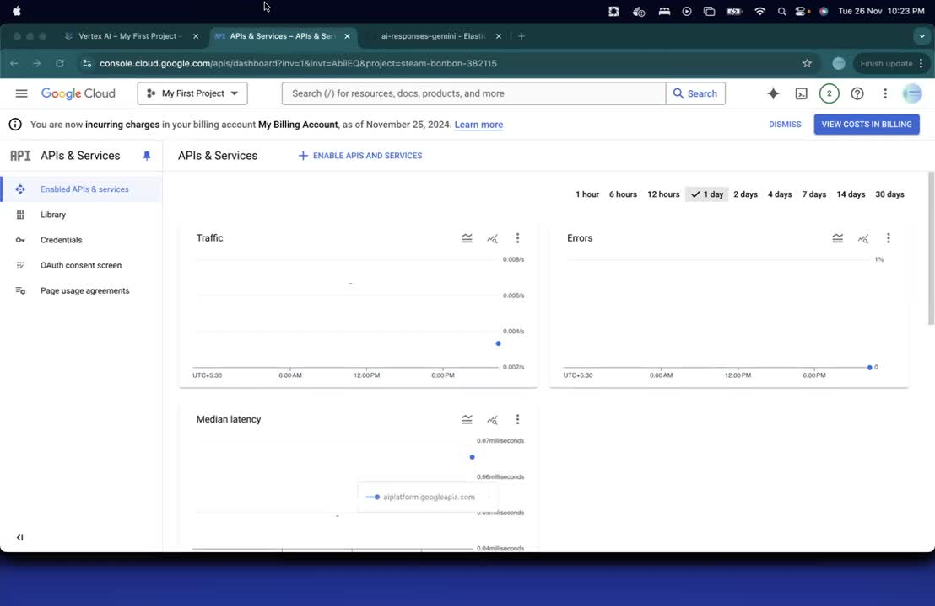
Demo

Slide 7


THANK YOU

